Slide 1
Development Stages
COS1005 – Web Development
Nimesh Wijetunge (106595861)

Slide 2
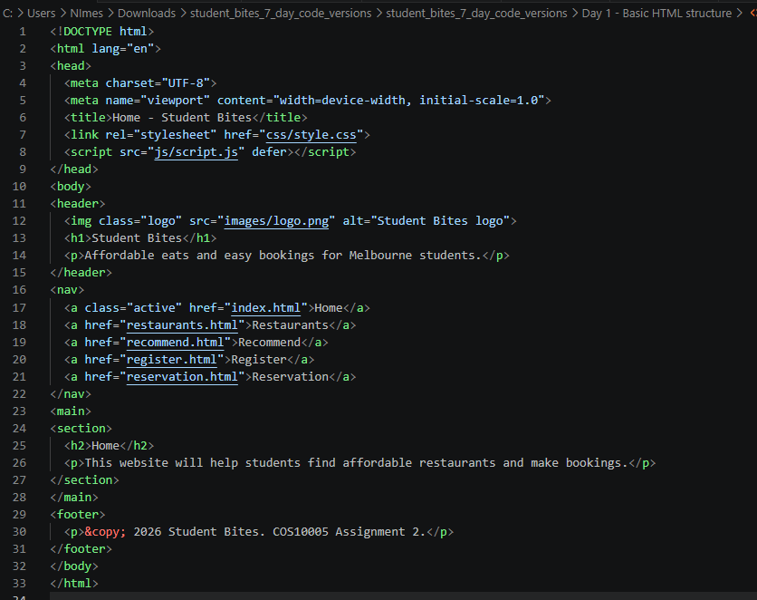
Index.html – 18/05/2026

Slide 3
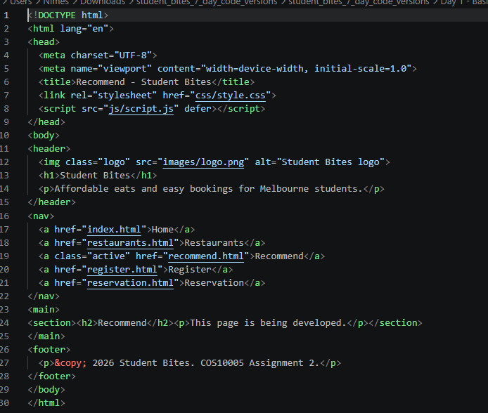
Recommend.html – 18/05/2026

Slide 4
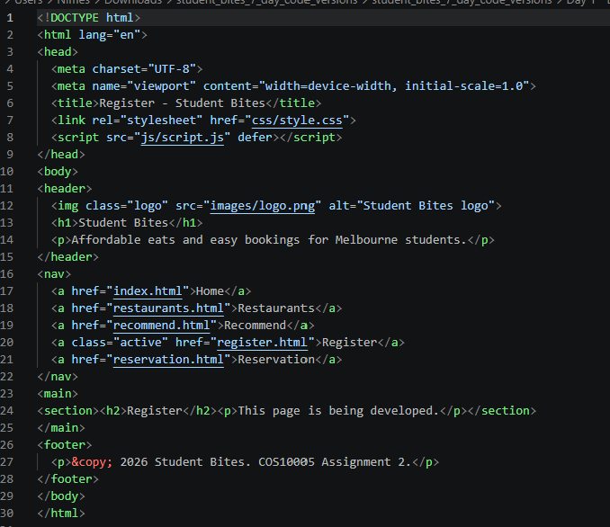
Register.html

Slide 5
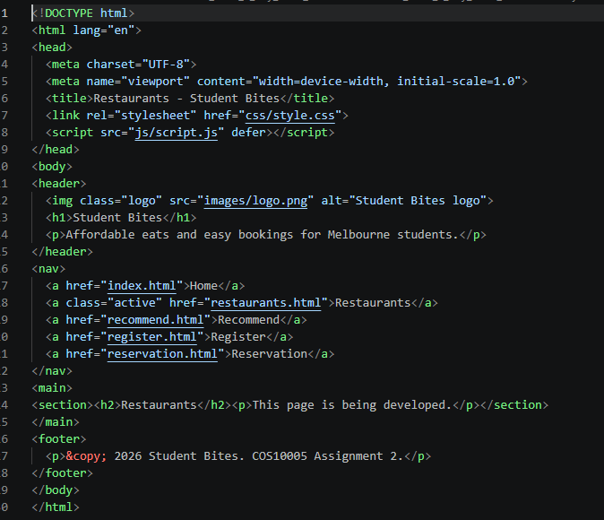
Resturants.html 18/05/2026

Slide 6
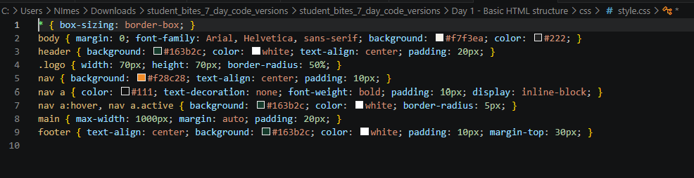
Style.css – 18/05/2026

Slide 7
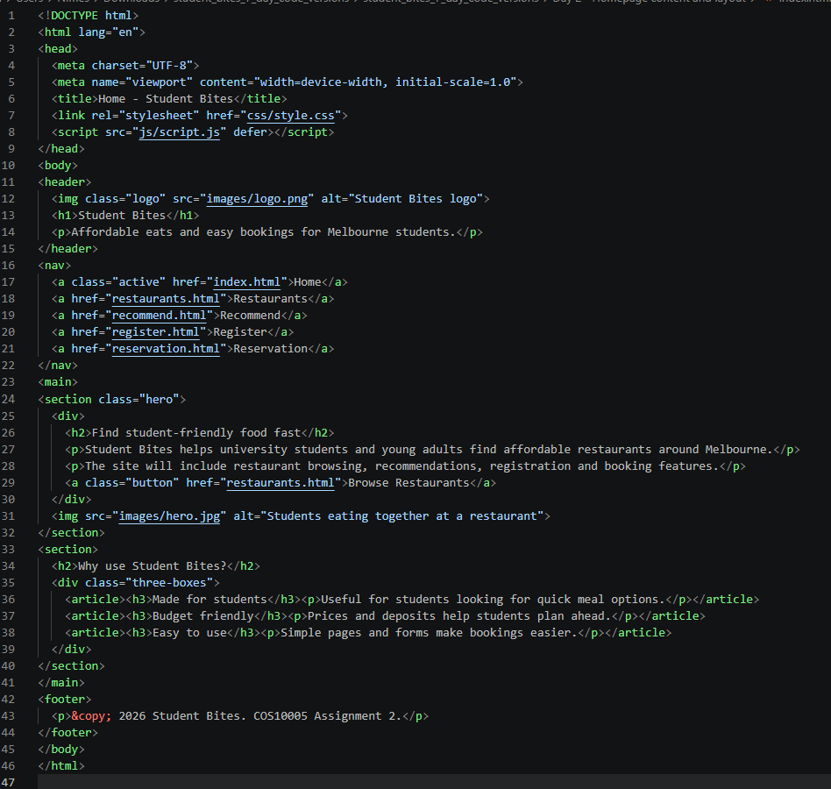
Index.html – 20/05/2026

Slide 8
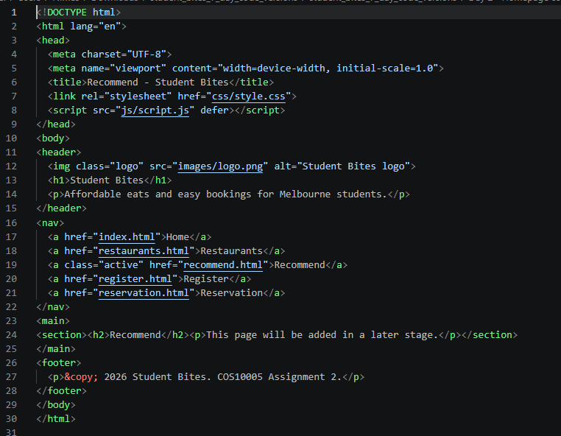
Recommended.html – 20/05/2026

Slide 9
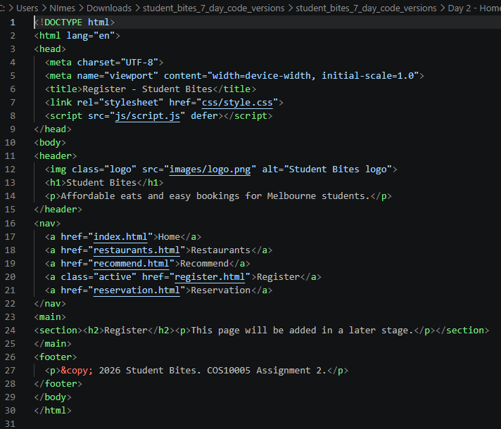
Register.html – 20/05/2026

Slide 10
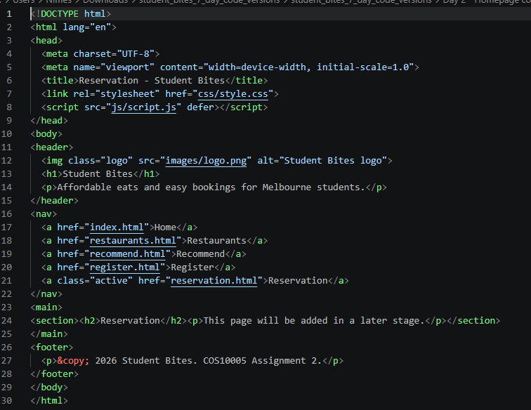
Reservation.html – 20/05/2026

Slide 11
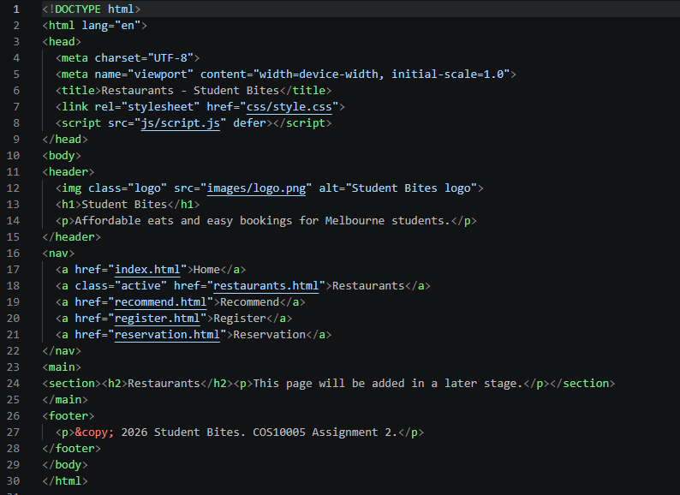
Restaurants.html – 20/05/2026

Slide 12
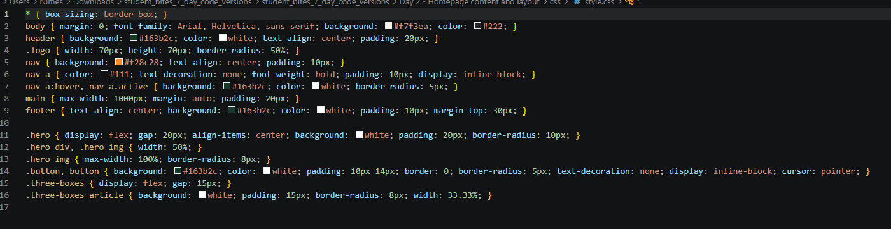
Style.css – 20/05/2026

Slide 13
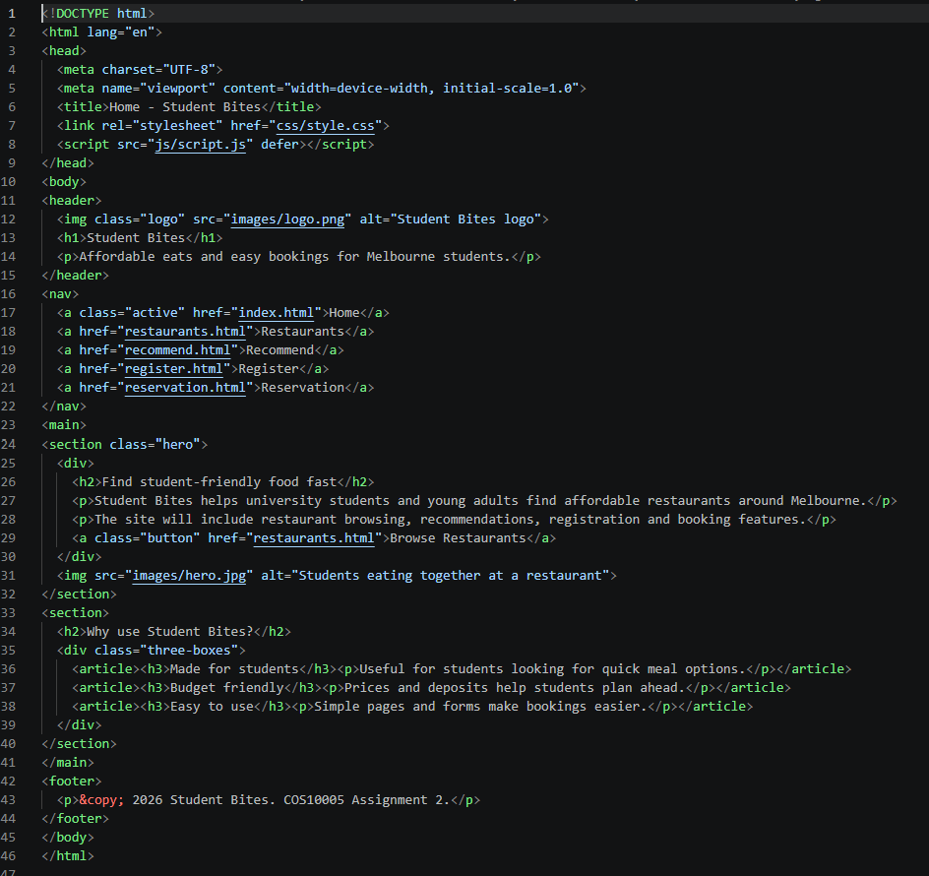
Index.html – 23/05/2026

Slide 14
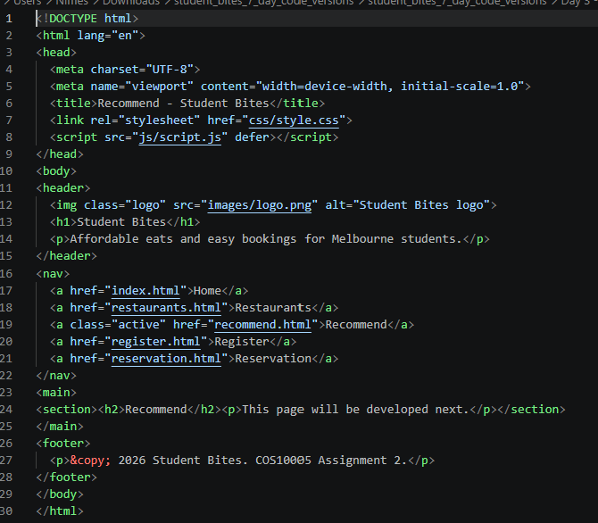
Recommend.html – 23/05/2026

Slide 15
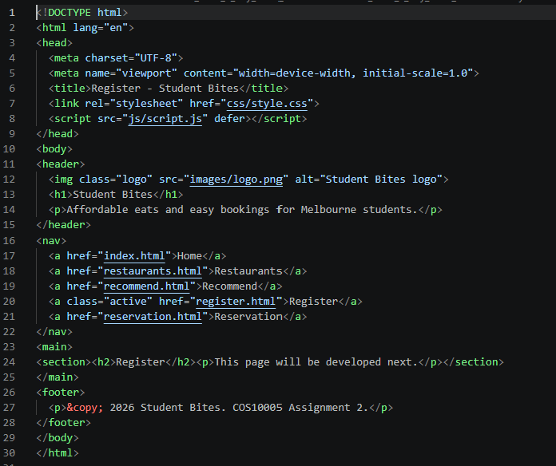
Register.html – 23/05/2026

Slide 16
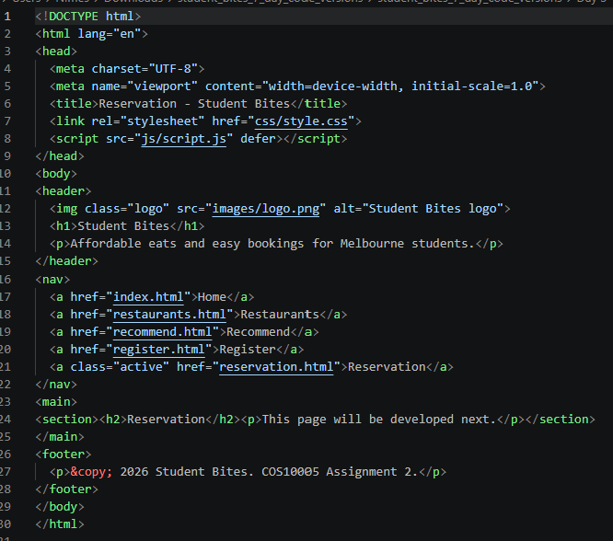
Resvervation.html – 23/05/2026

Slide 17
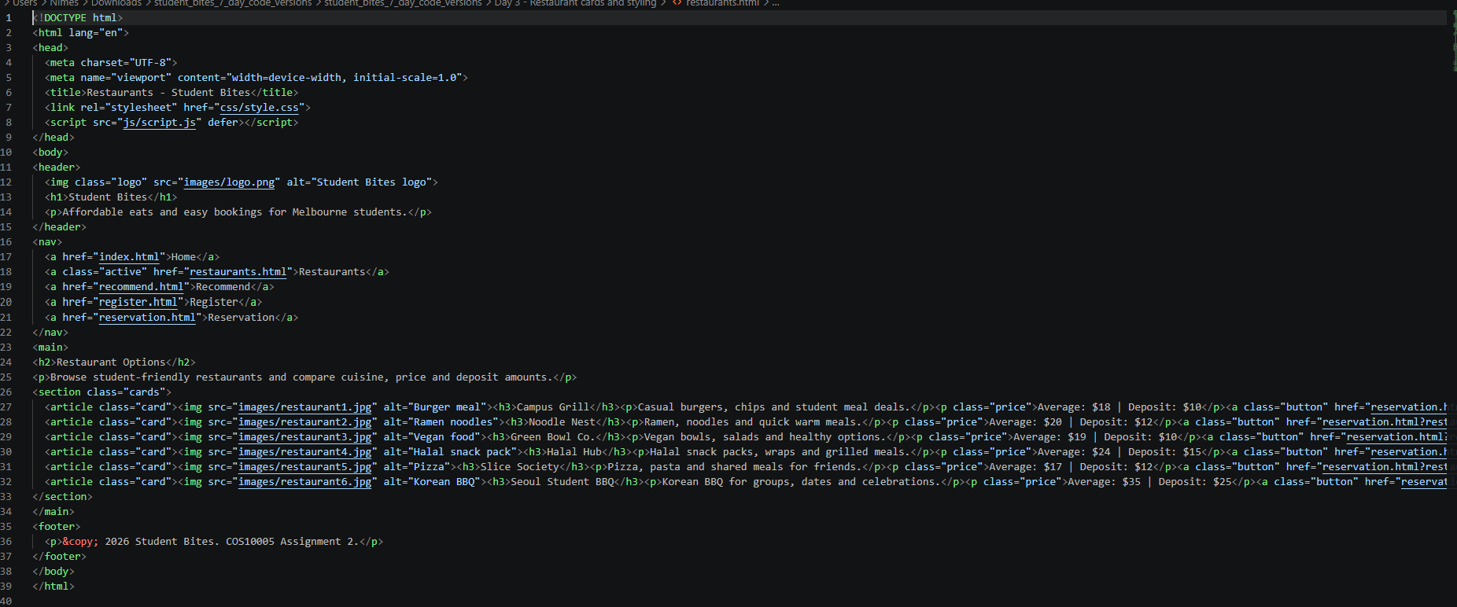
Restaurants.html – 23/05/2026

Slide 18
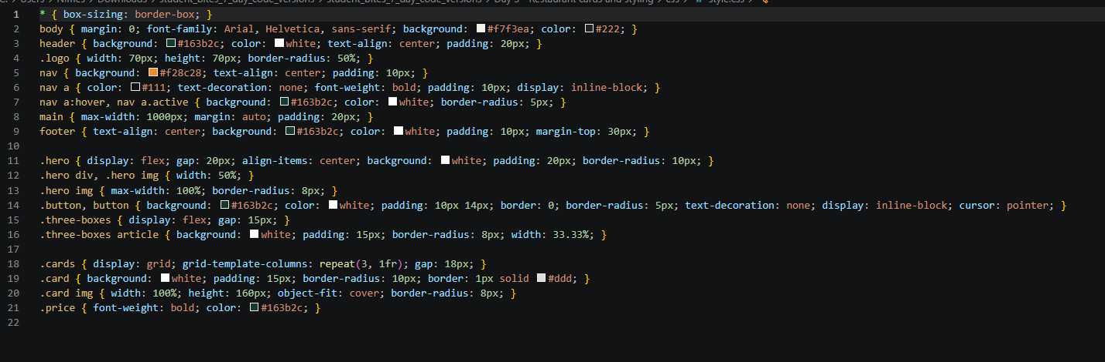
Style.css – 23/05/2026

Slide 19
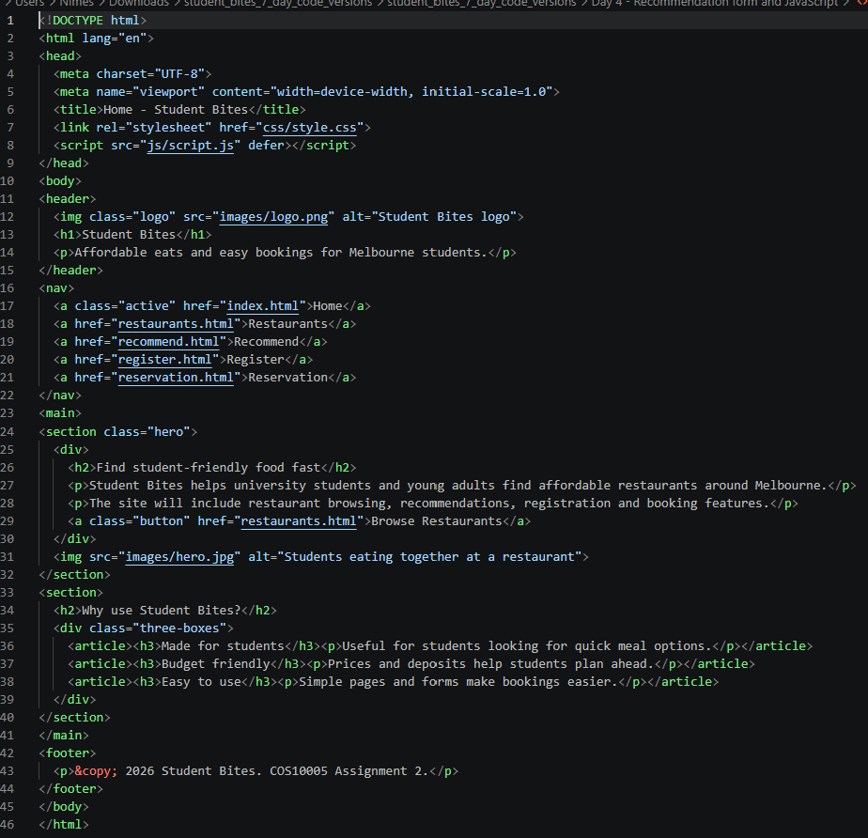
Index.html – 25/05/2026

Slide 20
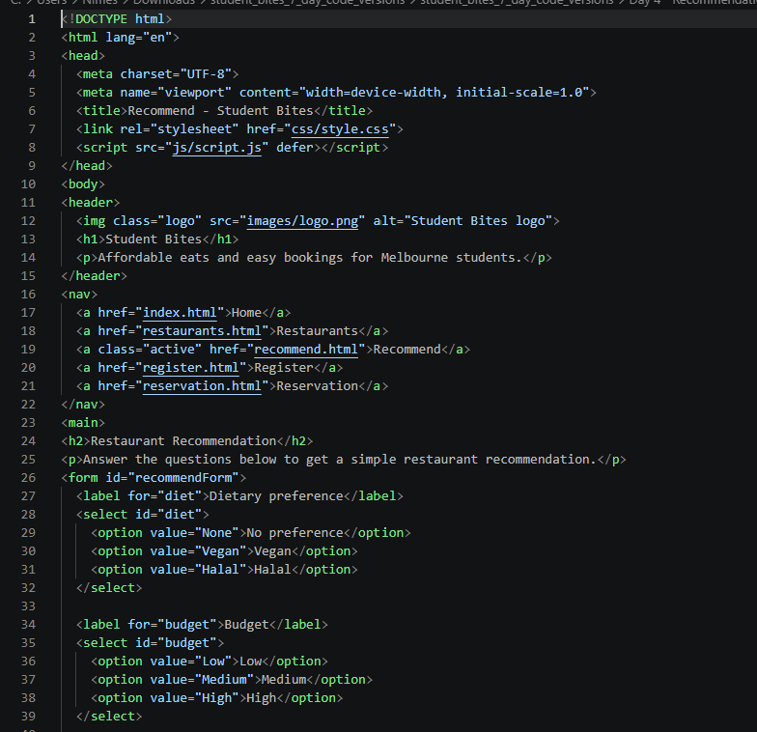
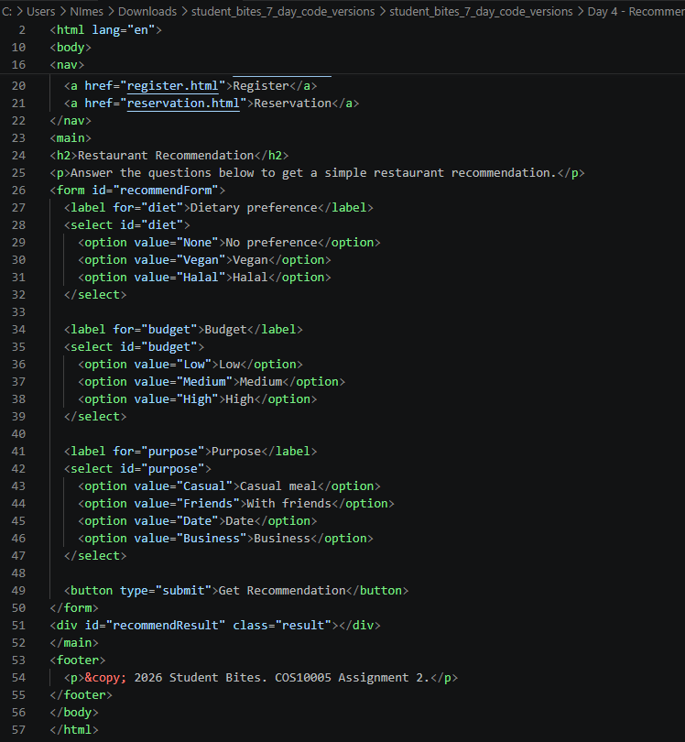
Recommend.html – 25/05/2026

Slide 21
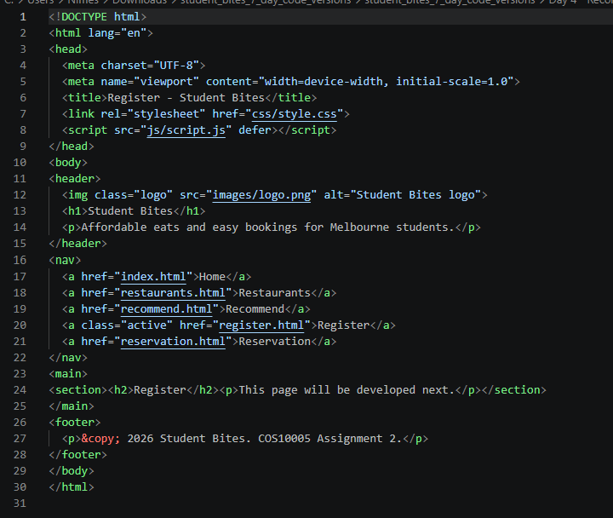
Register.html – 25/05/2026

Slide 22
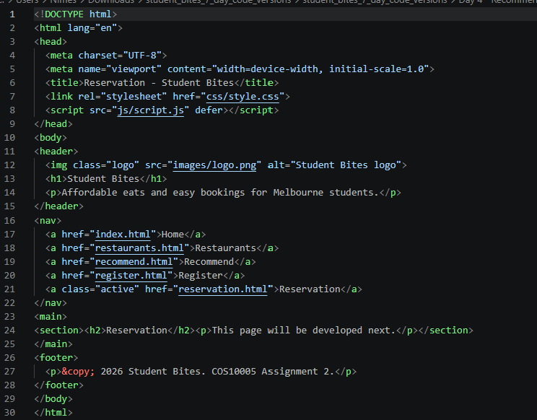
Reservation.html – 25/05/2026

Slide 23
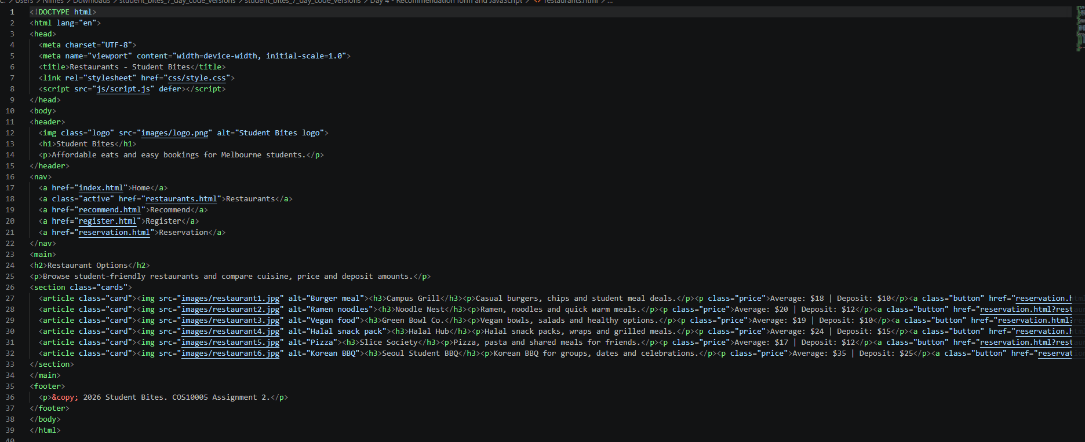
Resurant.html – 25/05/2026

Slide 24
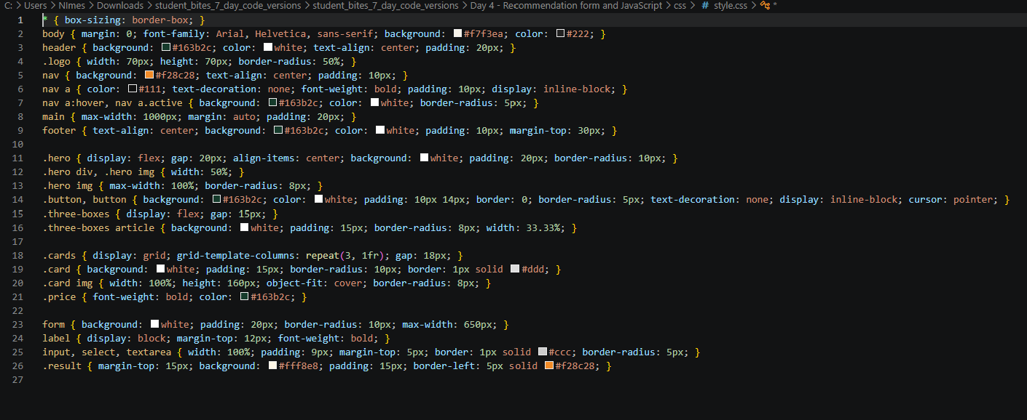
Style.css – 25/05/2026

Slide 25
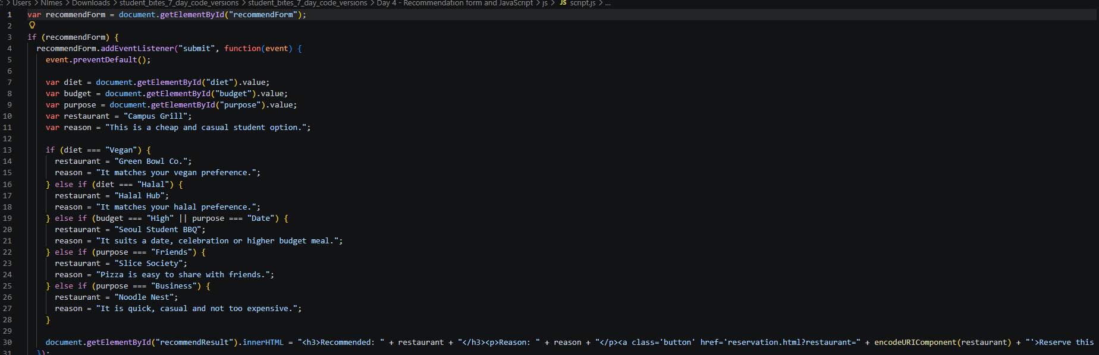
script.js – 25/05/2026

Slide 26
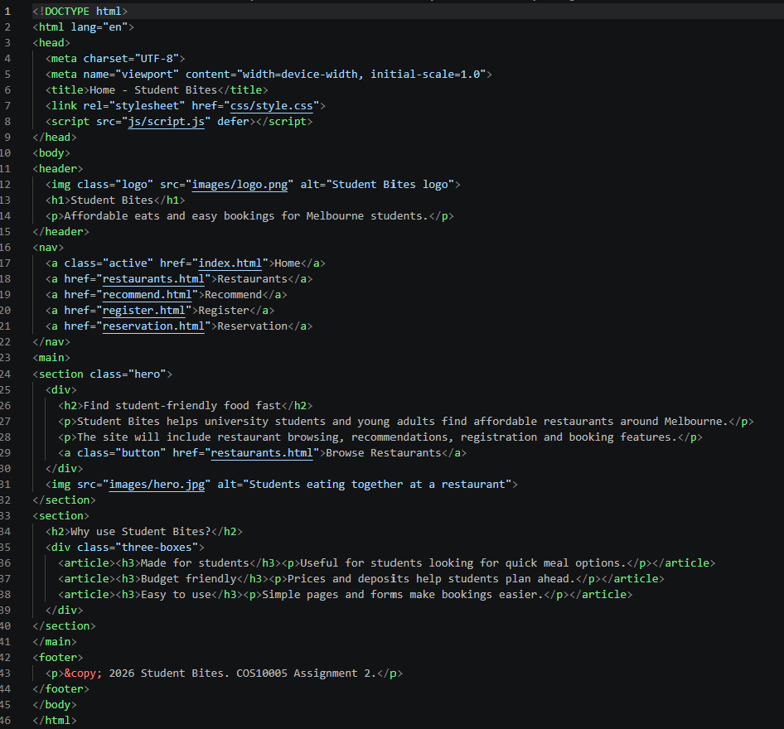
Index.html– 27/05/2026

Slide 27
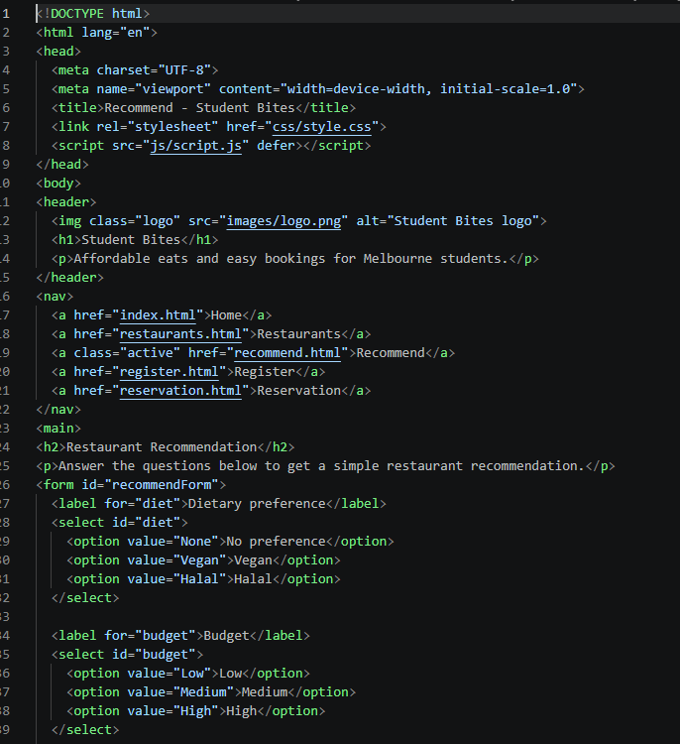
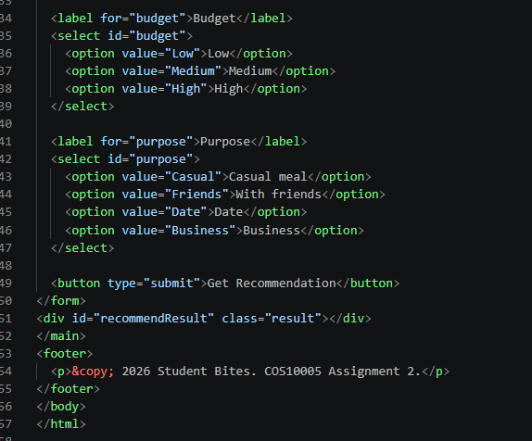
Recommended.html – 27/05/2026

Slide 28
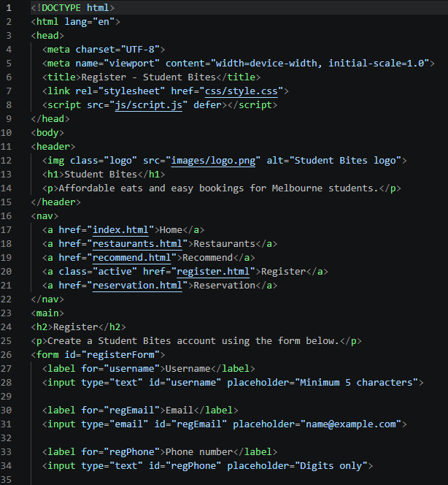
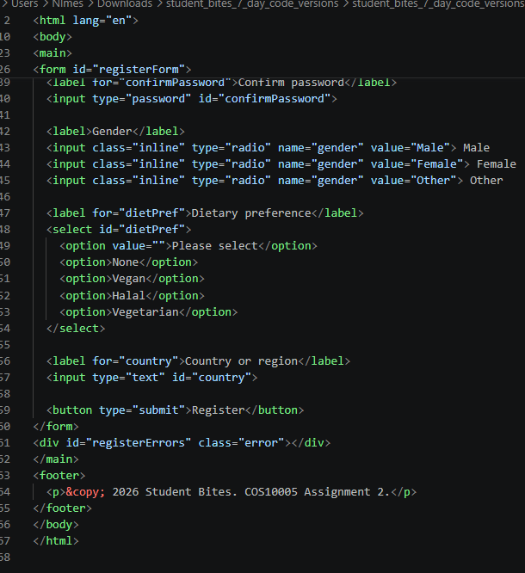
Register.html– 27/05/2026

Slide 29
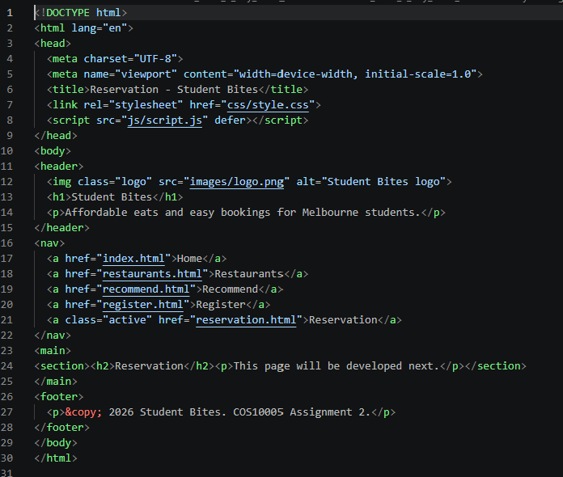
Reservation.html – 27/05/2026

Slide 30
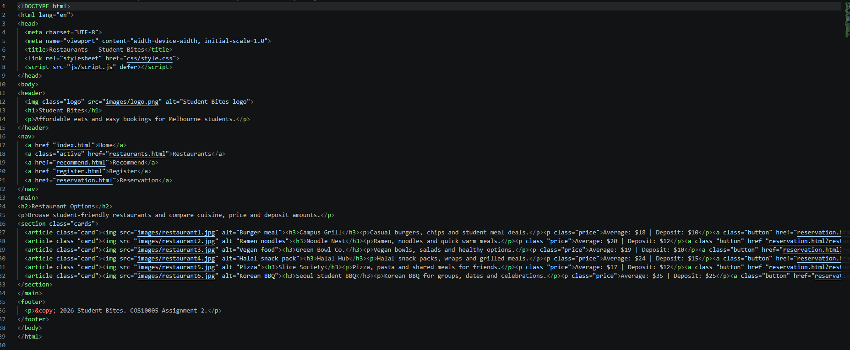
Restaurants.html – 27/05/2026

Slide 31
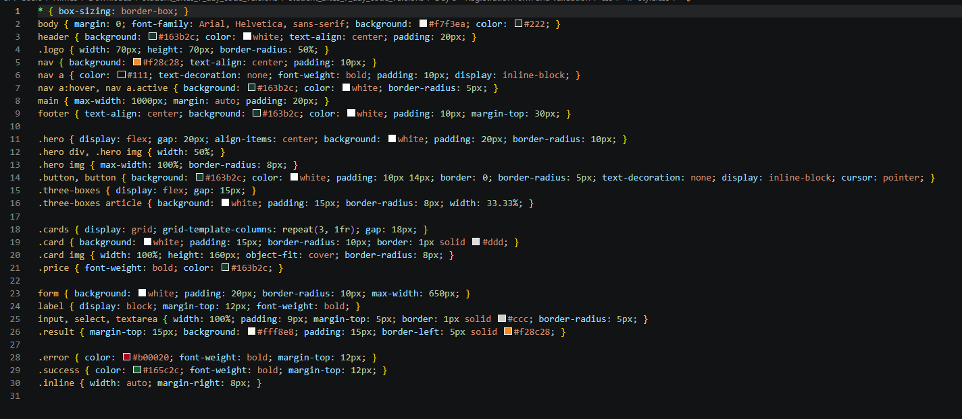
Style.css – 27/05/2026

Slide 32
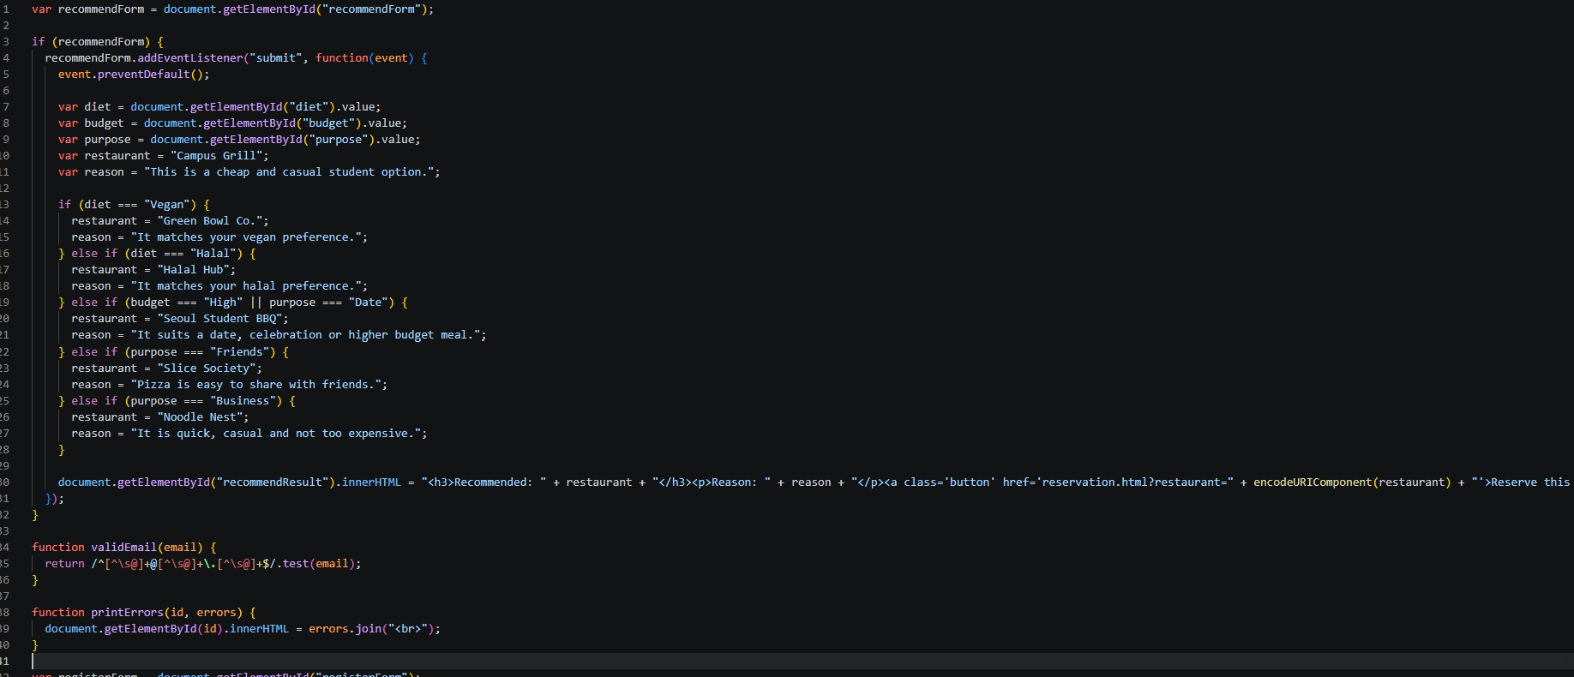
Script.js – 27/05/2026

Slide 33
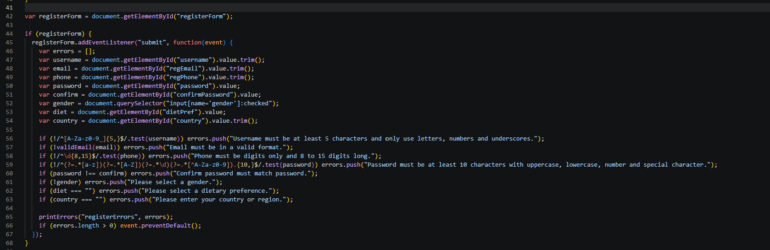
Script.js – 27/05/2026

Slide 34
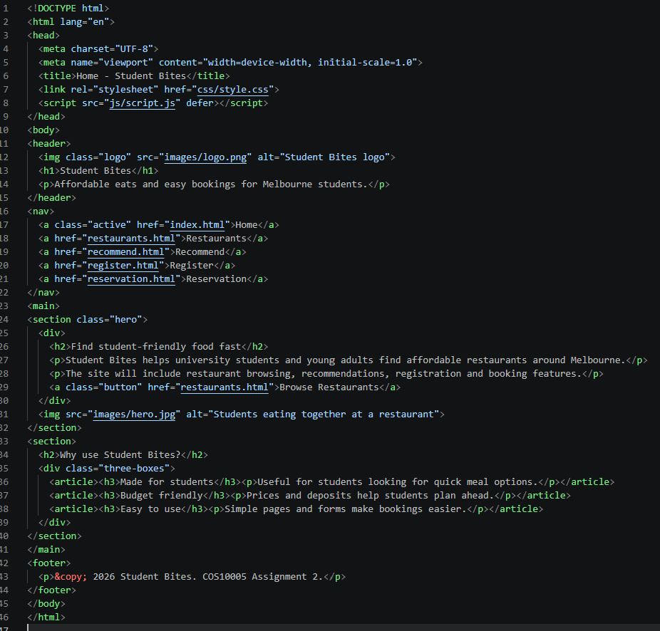
Index.html– 28/05/2026

Slide 35
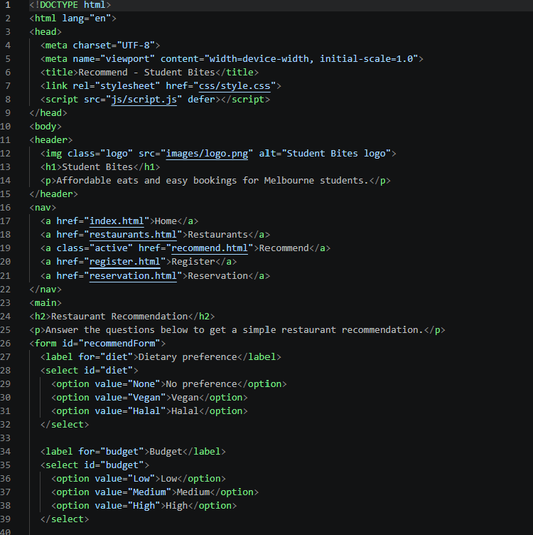
Recommend.html– 29/05/2026

Slide 36
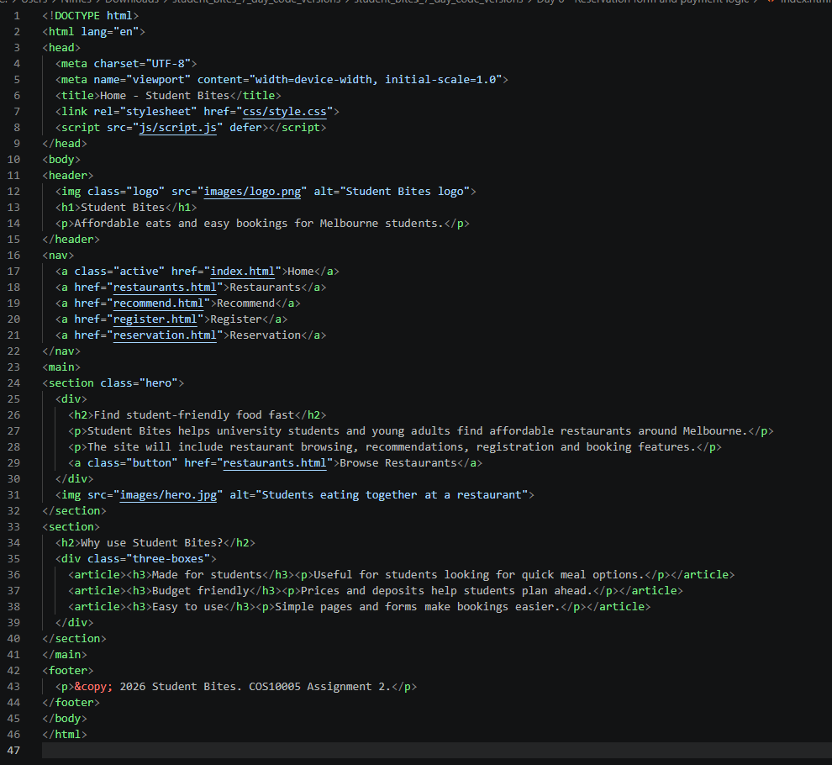
Index.html– 29/05/2026

Slide 37
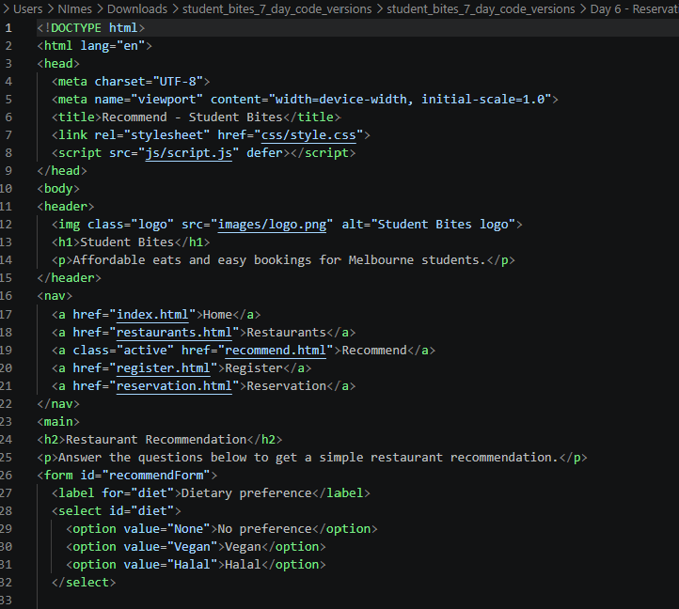
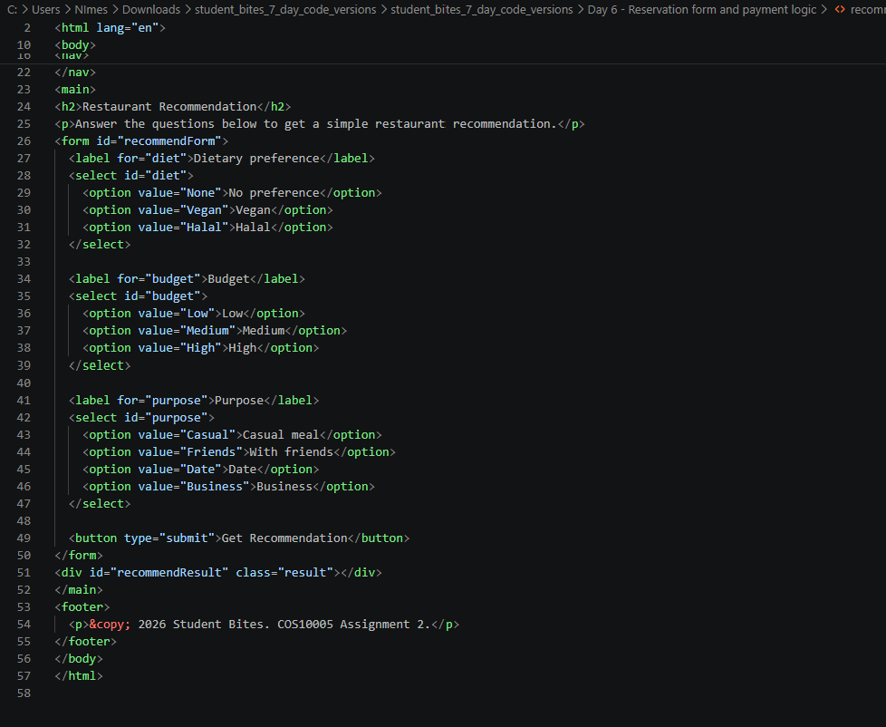
Recommended.html– 29/05/2026

Slide 38
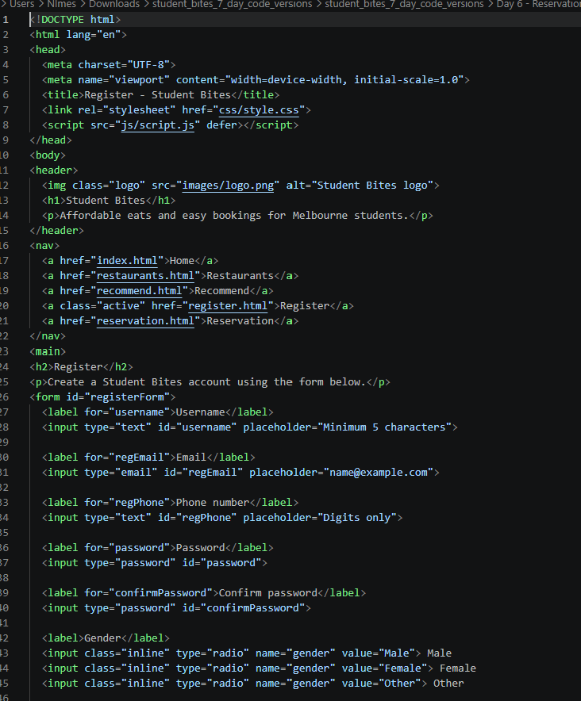
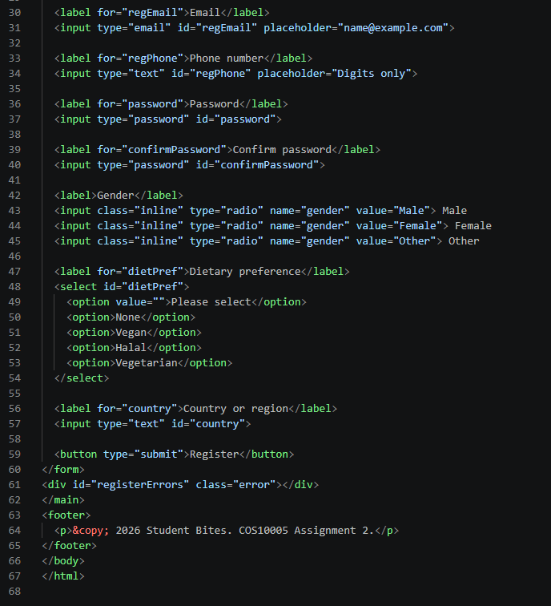
Register.html– 29/05/2026

Slide 39
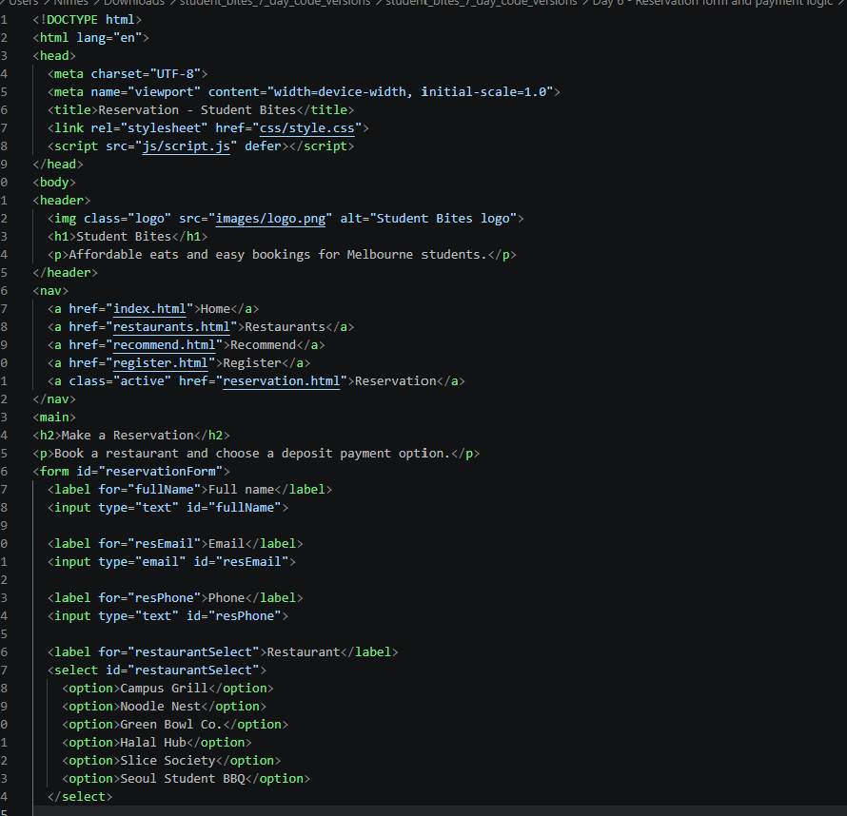
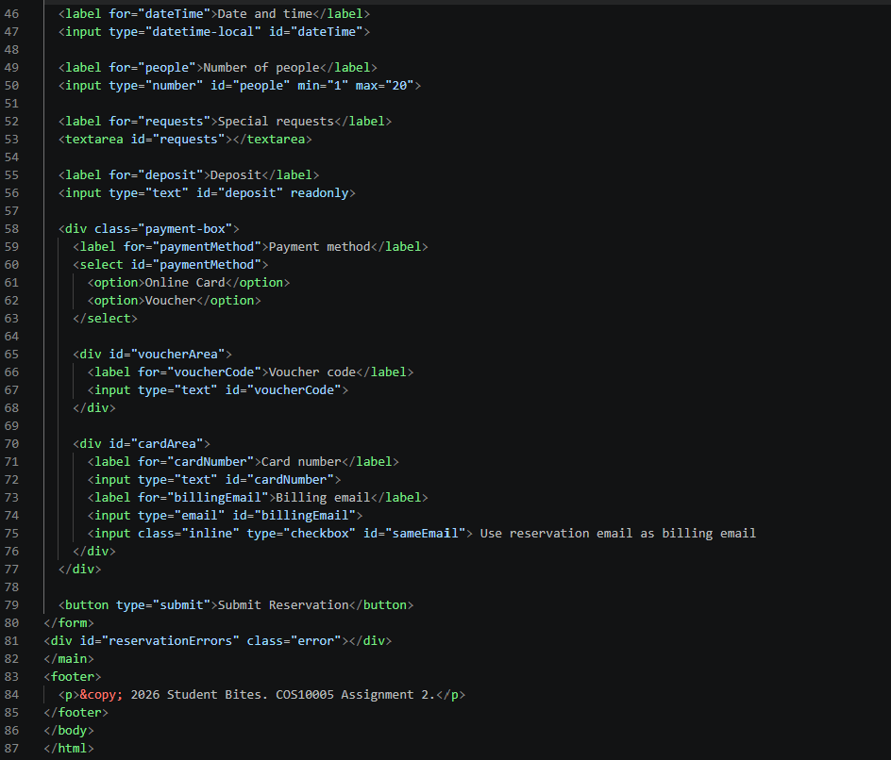
Reservation.html– 29/05/2026

Slide 40
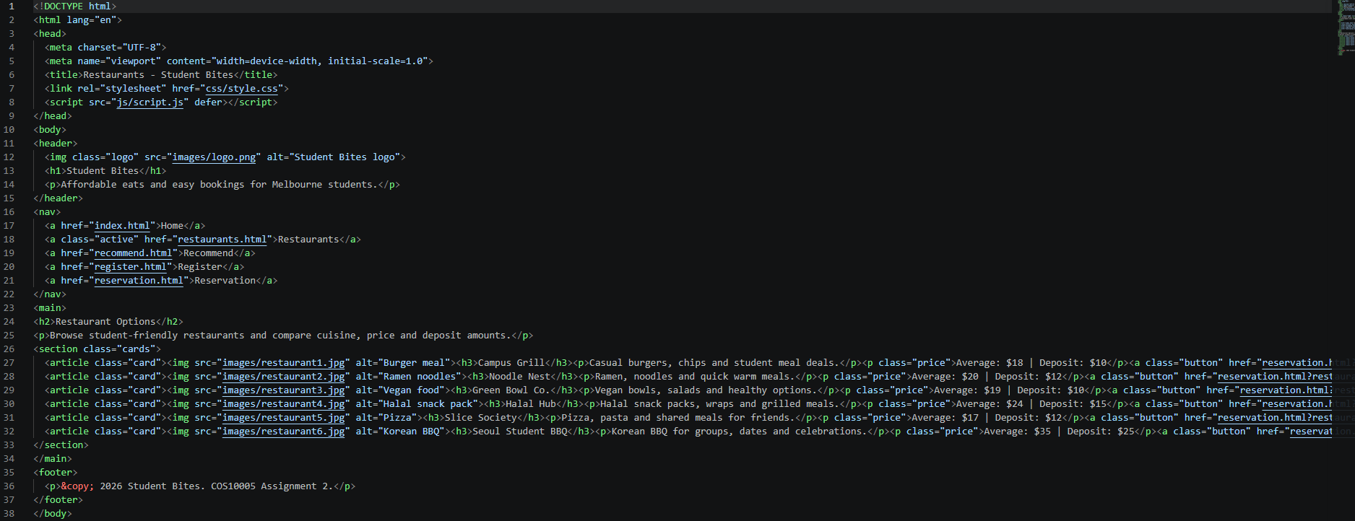
Resturants.html– 29/05/2026

Slide 41
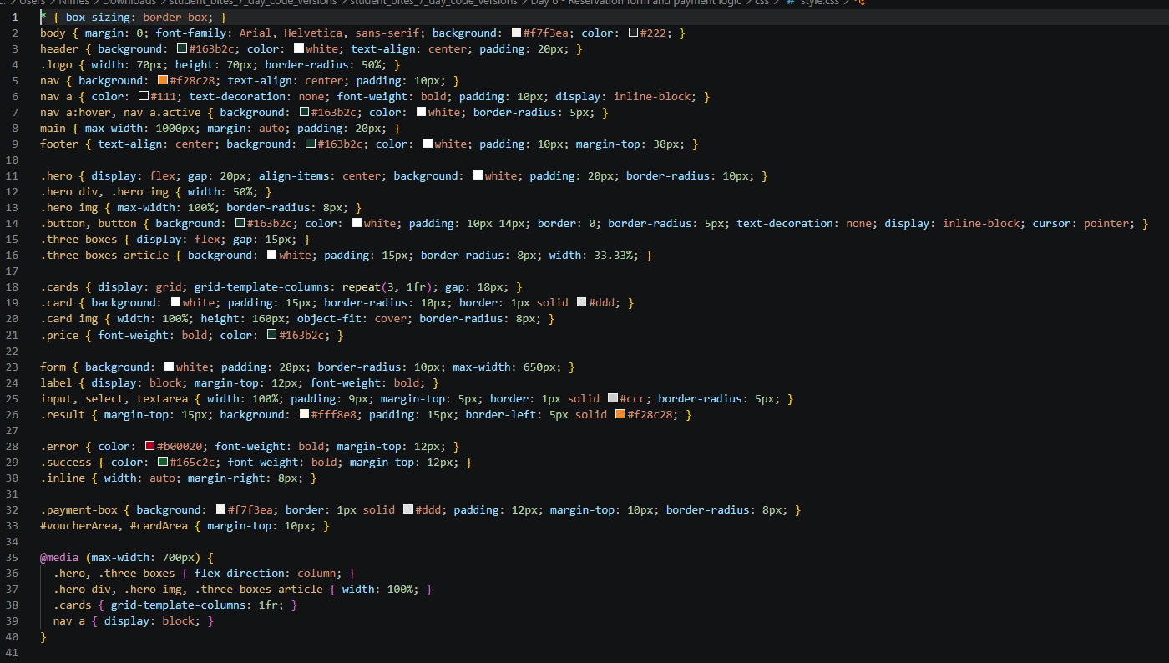
Style.css – 29/05/2026

Slide 42
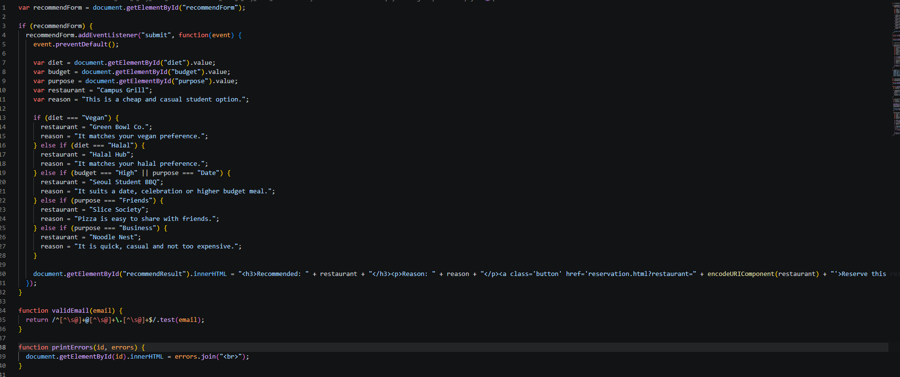
Script.js – 29/05/2026

Slide 43
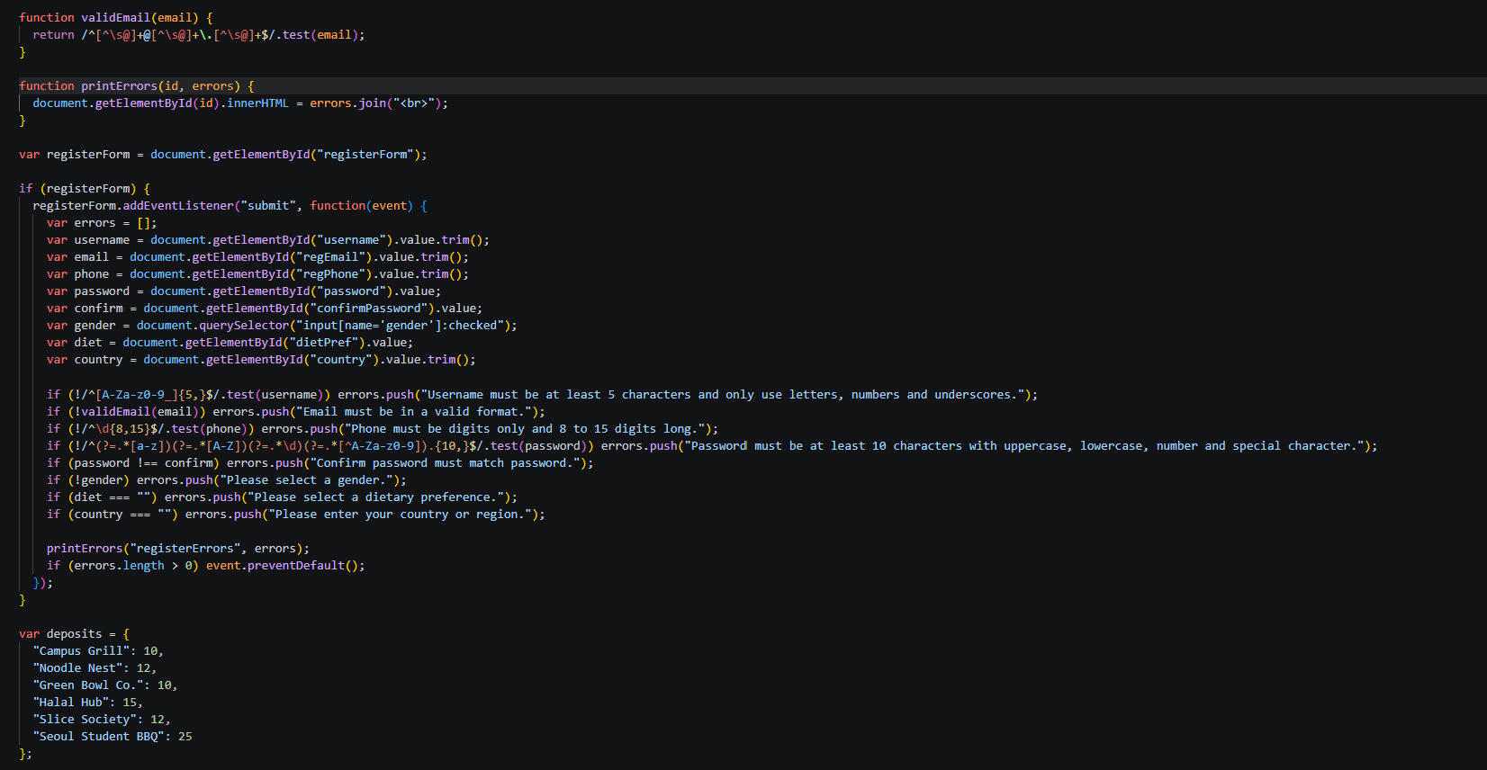
Script.js – 29/05/2026

Slide 44
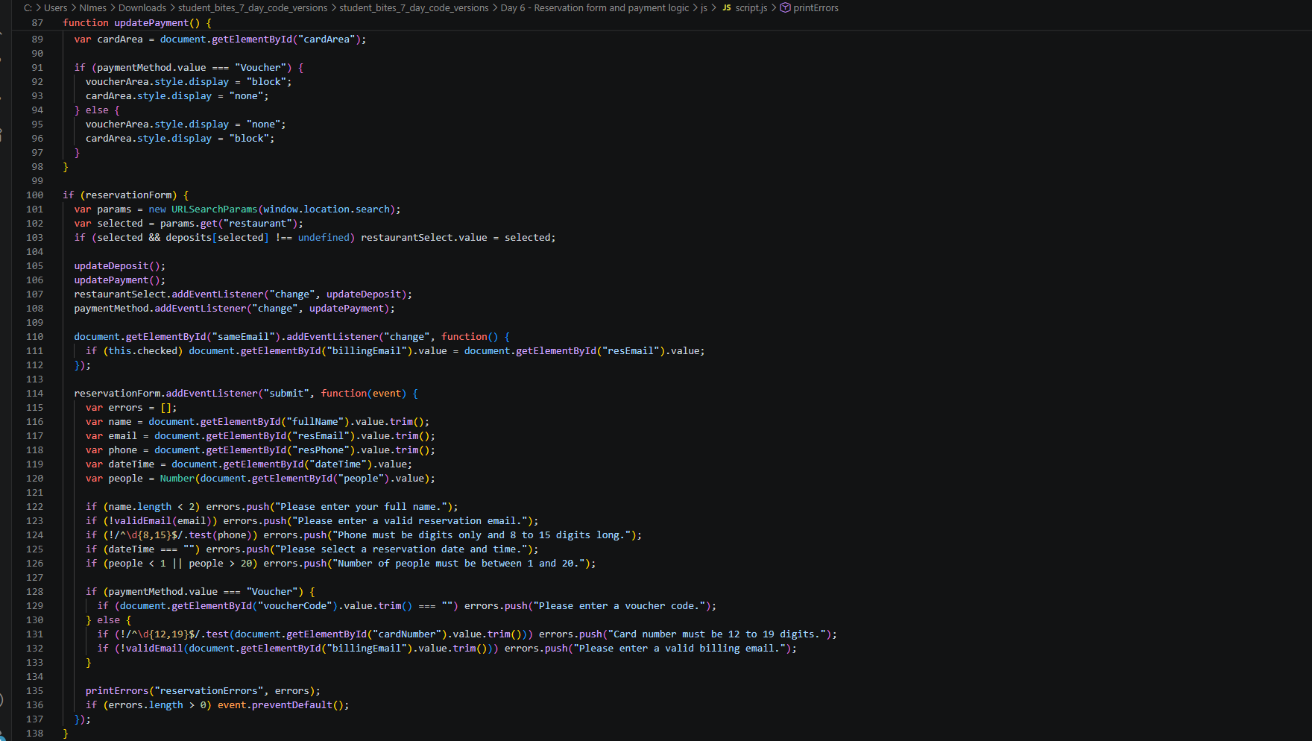
Script.js – 29/05/2026

Slide 45
Final Outcome – 30/05/2026
Please Look at final code

